Slide 1
What is the exchange rate today?
By Deborah Kewon

Slide 2
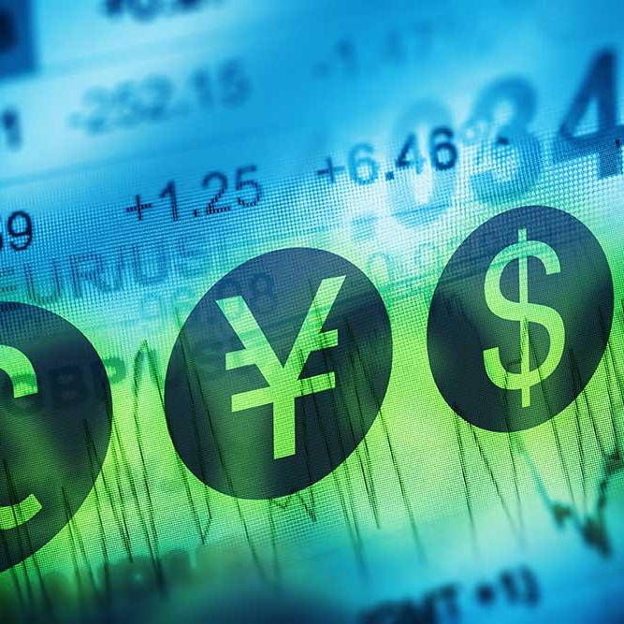
Objective
To help us decide when to exchange currency without losing money

Slide 3
How it works?
My program will first get the exchange rate from the finance website and automatically post it on Twitter every 5 hours as long as my Spyder is running.

Slide 4
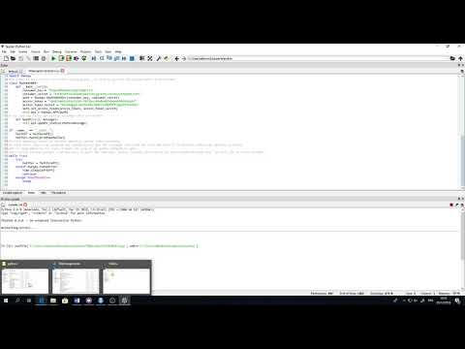
Video
https://www.youtube.com/watch?v=yloR4F8q-xk

Slide 5
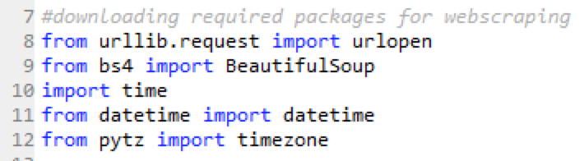
Importing required packages

Slide 6
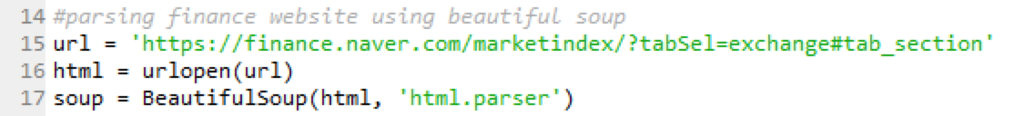
Data extraction from the finance website

Slide 7
Checking HTML source for the layout of the info

Slide 8
Cleaning Currency Format

Slide 9
Time of the Region

Slide 10
Recording exchange rate on the notepad called usdkor

Slide 11
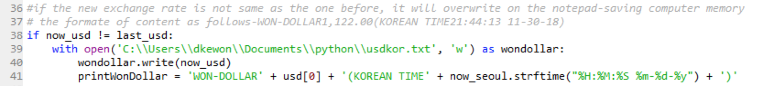
Posting Exchange Rate on Twitter

Slide 12
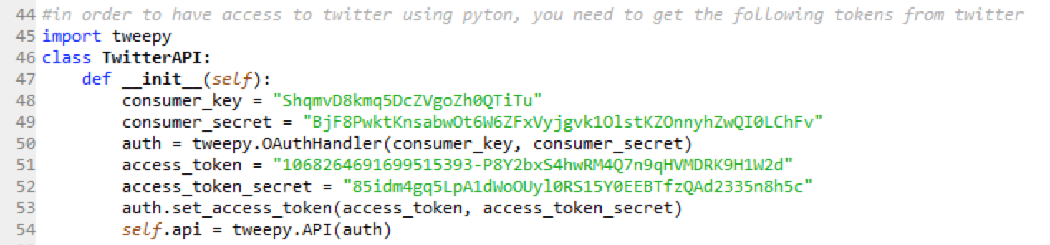
Having access to Twitter from Python

Slide 13
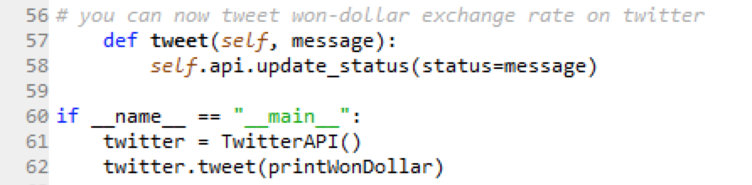
Tweeting Exchange Rate

Slide 14
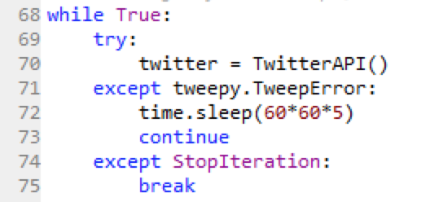
Automation!

Slide 15
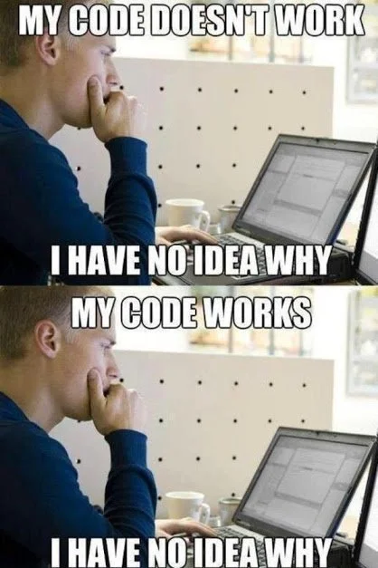
Duplication Error
Twitter Tokens
Automation
Time

Slide 16
Thanks!
Any questions ?

